Slide 1


Aviation Accidents Statistics
Contributors: Tyler Brown, Jordan Chatman, Rafael Rodriguez, Joseph Atemkuh

Slide 2


Slide | Slide Content
3
4
=G6-AIR=

Slide 3
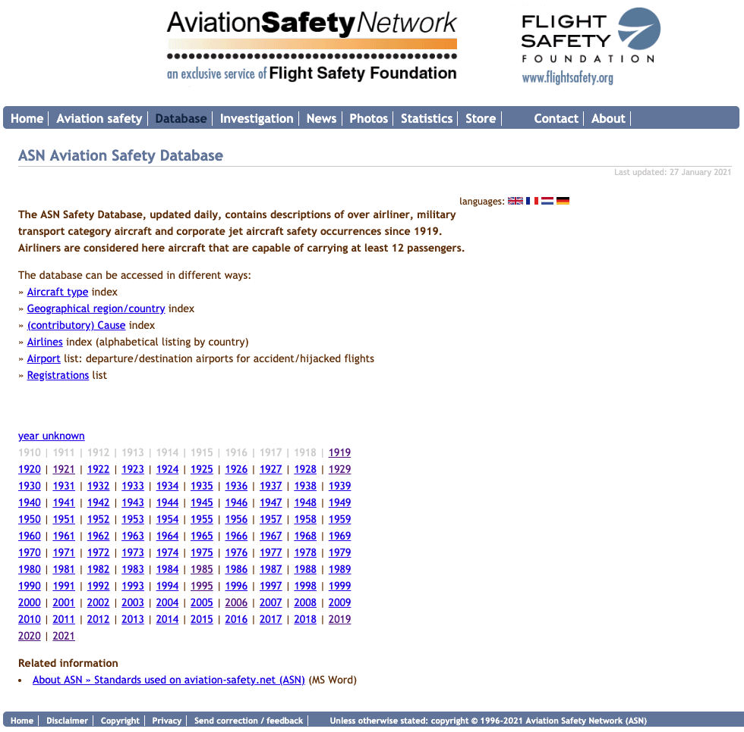
Introduction
As a group, our objective was to access the site, use the data provided to come up with the following
Accidents statistics over a period
Accidents but Continents
Identify the worst 25 geographical accidents by regions
Identify a list of 100 worst accidents, which include ground fatalities
In other to achieve this, the following tools were used
Jupyter Notebook to scape and sort data, MongoDB for database, Flask for interaction, JavaScript for plotting of graphs, and HTML for end-user visualization.
=G6-AIR=
Notes:
Leadership is how an individual mobilizes people and resources to achieve a particular goal by using both skill sets that can be learned and specific attributes that can be nurtured.
These may include inspiring, challenge, and encourage others or influence and persuade their followers. An autocratic leader makes decisions without consulting their team members, while a democratic leader includes the team in the decision-making process. We also have a ‘Laissez-Faire’ (Leave alone) Leadership approach, where team members are provided with a large degree of freedom on their work and the setting of their deadlines.

Slide 4

Worst geographical regions
List of the 25 geographical regions having the
highest number of fatal civil airliner accidents from
1945 until now. Military accidents, corporate jets,
hijackings (and other criminal occurrences)
are not included.
Our list toping is the United States with 860 accidents,
10820 fatalities, and 133 ground fatalities. Argentina
being the least with 43 casualties, 819 fatalities and
3 ground fatalities
=G6-AIR=
Notes:
Leadership is how an individual mobilizes people and resources to achieve a particular goal by using both skill sets that can be learned and specific attributes that can be nurtured.
These may include inspiring, challenge, and encourage others or influence and persuade their followers. An autocratic leader makes decisions without consulting their team members, while a democratic leader includes the team in the decision-making process. We also have a ‘Laissez-Faire’ (Leave alone) Leadership approach, where team members are provided with a large degree of freedom on their work and the setting of their deadlines.

Slide 5
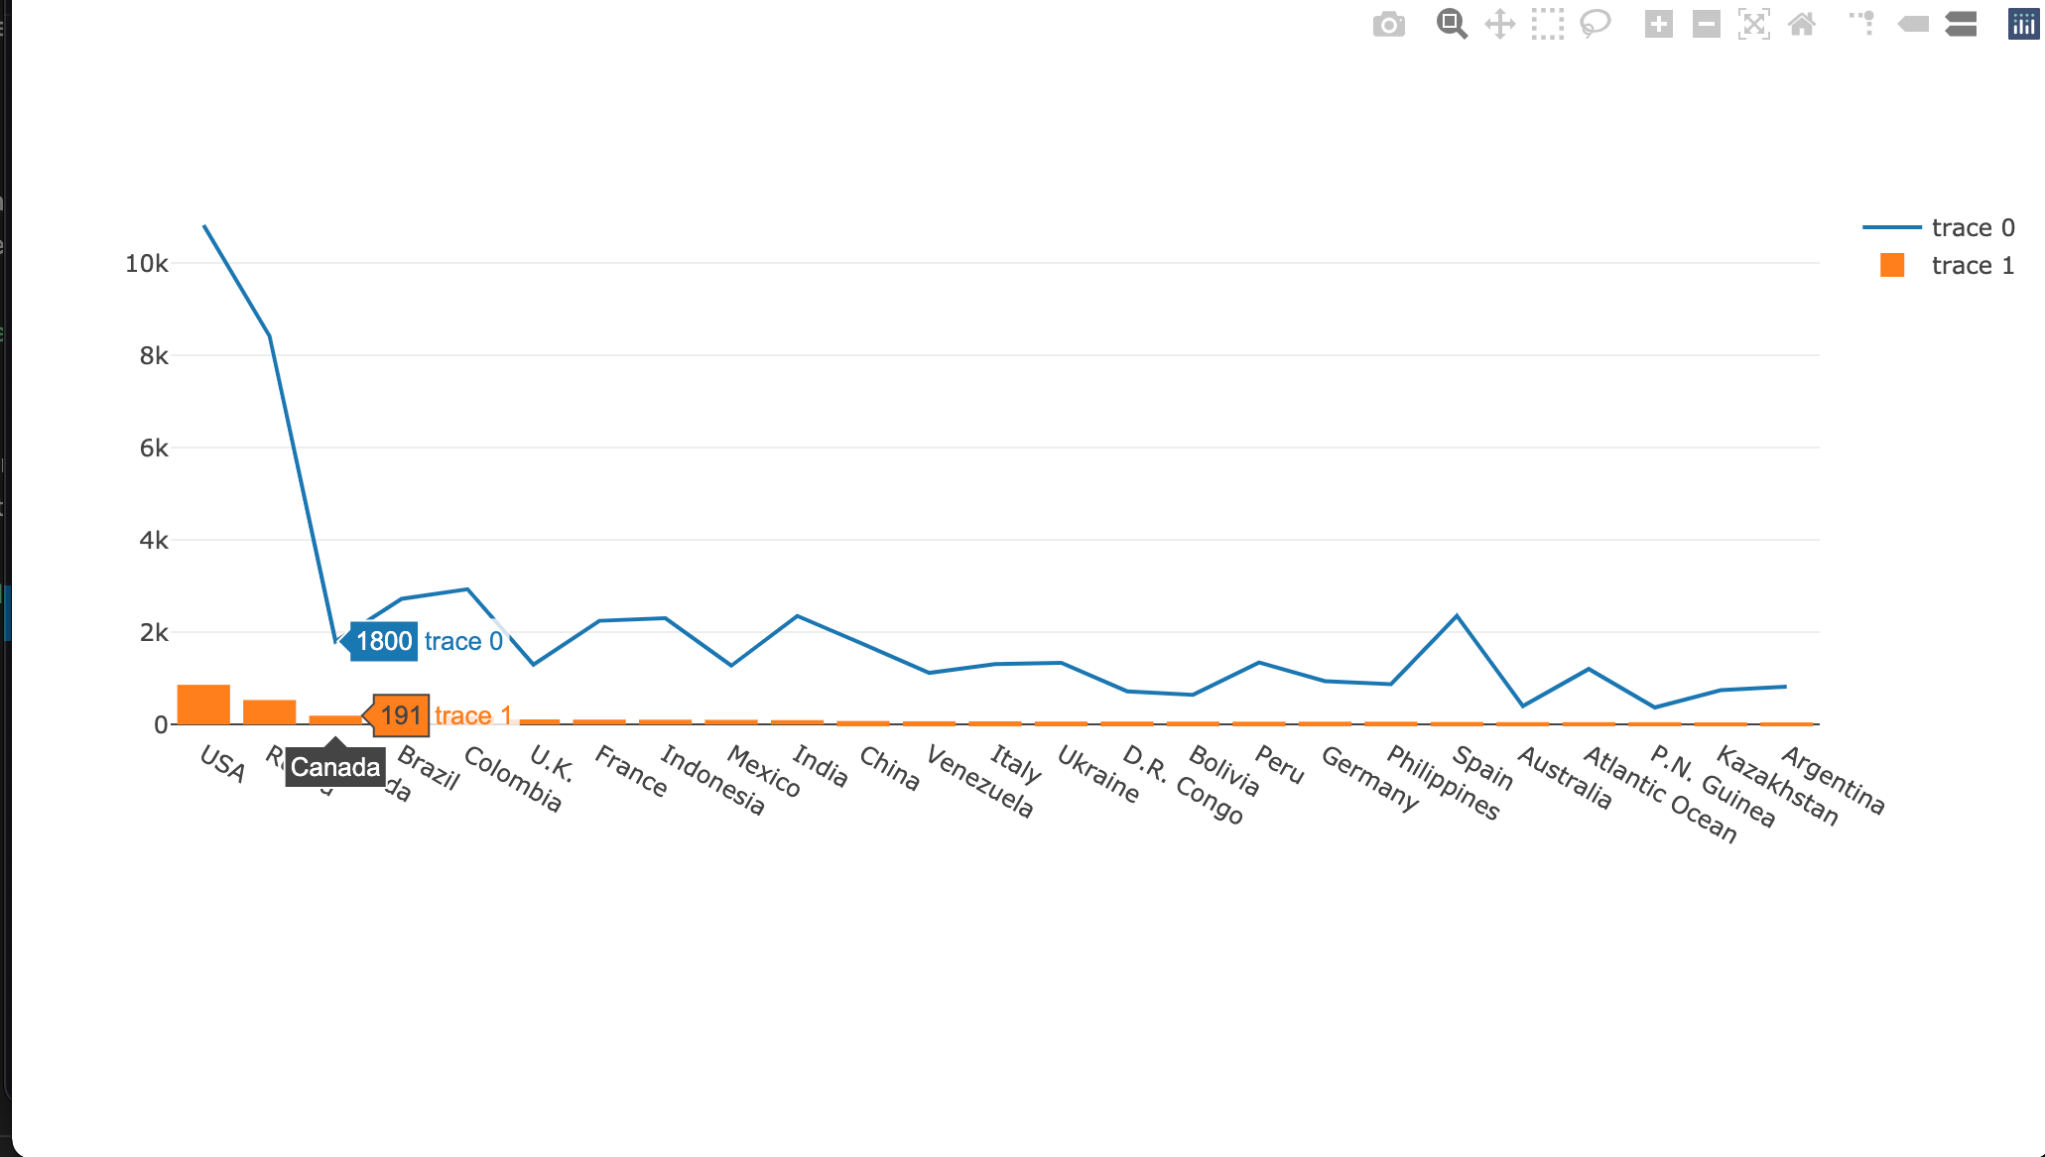
Worst Continental Accidents
Europe has the most accidents at 1171,
fatalities at 23716, ground fatalities 188, and
the least Antarctica with 6 accidents, 276 deaths,
and zero ground fatalities not surprising
because nobody inhabits that part of the planet
=G6-AIR=

Slide 6
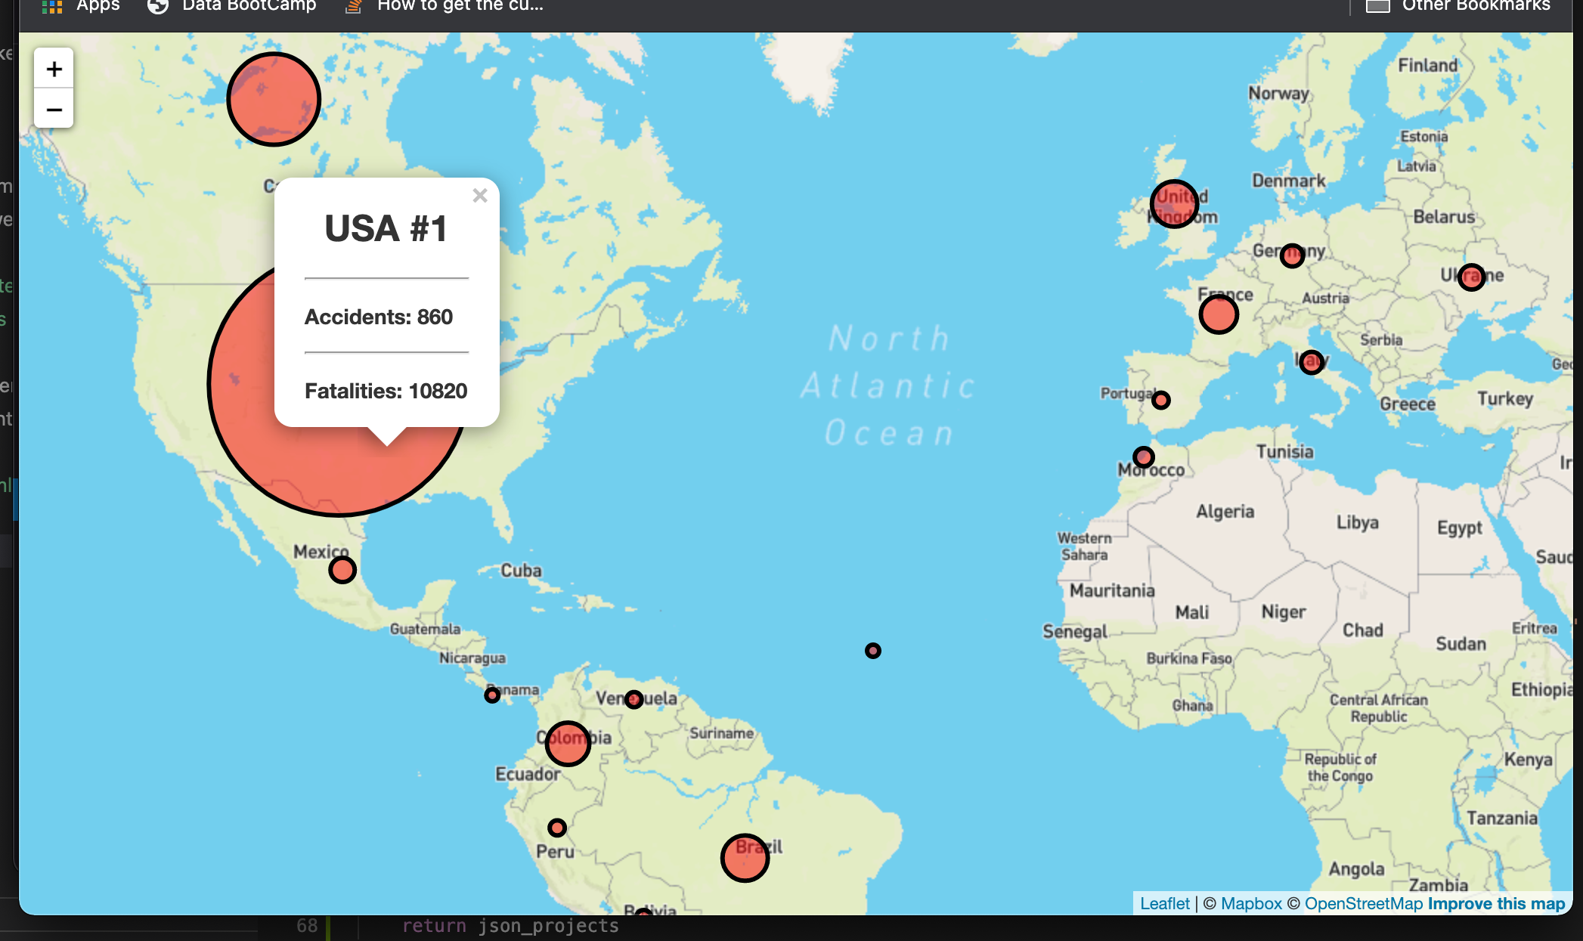
100 worst accidents, including ground fatalities above 100
100 worst accidents, including ground fatalities above 100
This list of 100 worst aviation occurrences (including criminal events), including ground fatalities, including collision fatalities. We identified September 11, 2001, as the most fatal day in aviation history with 1692 deaths; obviously, these were not all passengers in the aircraft. We all know this was terrorist activity. The location was the United States
The least worst fatalities is noted to have happened on June 08, 1982, in Brazil. This was caused by human error on the part of the pilot.
GROUP 6

Slide 7
Large image
QUESTIONS
=G6-AIR=

Slide 8


Thank You
=G6-AIR=

